Slide 1
Internal Assessment 1
Vishal Rao

Slide 2
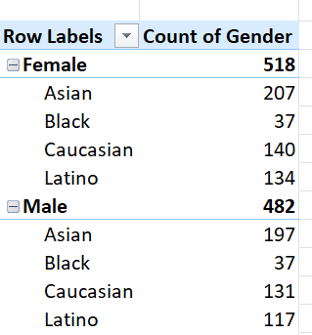
Case 1
Used a pivot table dragged gender ands ethnicity in rows and count of gender

Slide 3
Case 2
Used a pivot table dragged gender ands ethnicity in rows and count of gender

Slide 4
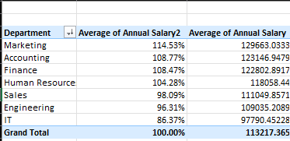
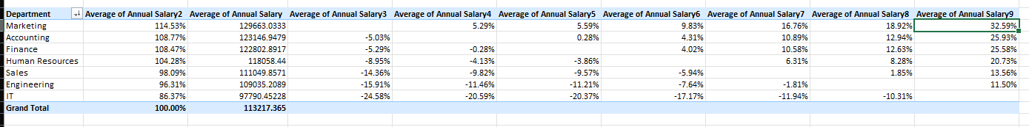
Case 3
Used a pivot table dragged department into row and average of annual salaries , observed that there is a significant difference in department with respect to IT and marketing as we could see in the second image the difference in percentage of annual salaries with respect to IT is drastic

Slide 5
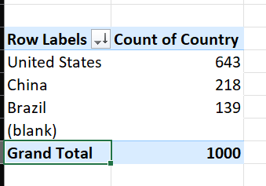
Case 4
United states has highest count of employee

Slide 6
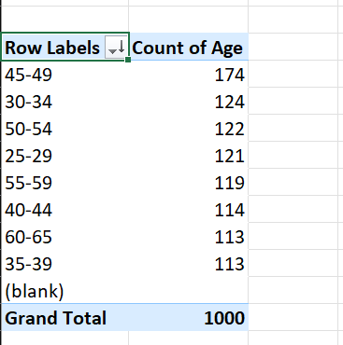
Case 5
Used pivot table added age to the rows and count of age to value and then grouped the rows with the range of 5 , found age of range 45-59 had the most employees

Slide 7
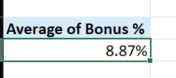
Case 6
Pivot table and found the average of bonus , answer is around 8.87%

Slide 8
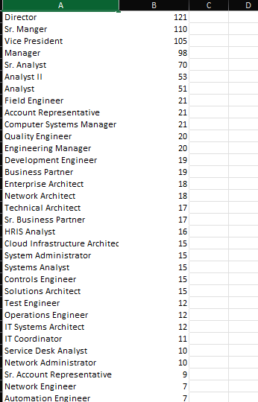
Case 7
Used a pivot table position name and count of them , found directors position has the most counts

Slide 9
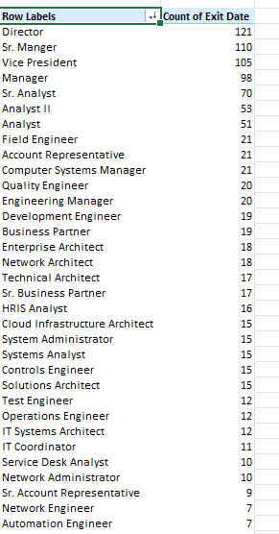
Case 8
Took a pivot of positions and count of exit dates and sorted to descending order , found that directors had most exits , could be the change of management , director being the top position in the hierarchy

Slide 10
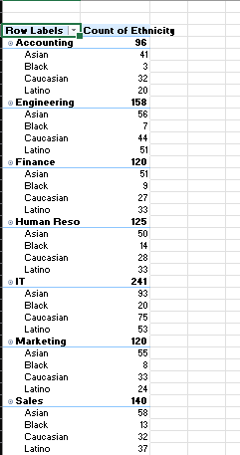
Case 9
Found that IT, Sales ,HR had good distribution of eithinicity when compared to other where few groups had counts in single digits

